Slide 1
Spam Email Classification
Wahaj Javed Alam 20K-0208
Muhammad Hatif Mujahid 20K-0218
Muhammad Faheem 20K-1054

Slide 2
Introduction
Definition of email spam:
Unsolicited or unwanted email messages sent in bulk to a large number of recipients.
Often used for fraudulent or malicious purposes.
Importance of detecting email spam:
Protects users from scams, phishing attacks, and malware.
Saves time and resources by reducing the number of unwanted emails received.
Brief overview of the project:
Use machine learning to detect email spam.
Bring as much accuracy as possible when detecting spam emails.

Slide 3
Dataset
Brief description of the dataset used for the project:
Dataset contains email messages labeled as spam or non-spam.
Each row contains the number of times a word occurs in that email.
Number of samples and features:
5,172 email samples in total.
There are 3002 features. The first column indicates Email name. The last column has prediction: 1 for spam, 0 for not spam.
The remaining 3000 columns are the most common words in all the emails, after excluding the non-alphabetical characters/words.
Source of the dataset:
The dataset was sourced from Kaggle.
Link to the dataset: Email Spam Classification Dataset CSV | Kaggle

Slide 4
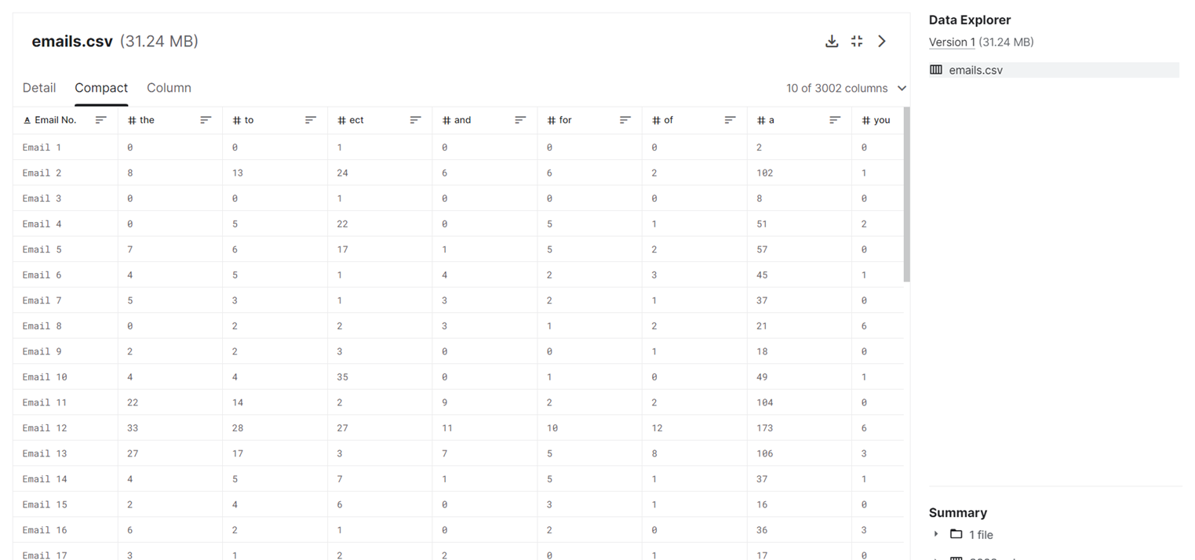
Dataset: A compact view

Slide 5
Data Preprocessing
Cleaning the data:
Removing stopwords: common words that do not provide useful information for classification (e.g. "the", "and", "a").
Removing columns names with less than 3 characters: columns with such names do not add any useful information (Dimensionality reduction)
Splitting data into test and train:
Randomly dividing the dataset into two subsets: one for training the and one for testing the performance of the models.
The typical split is around 80% for training and 20% for testing.
Feature extraction :
TF-IDF is a commonly used technique that measures the importance of each word in the document by
The result is a matrix of numerical values that represent the importance of each word in each document.

Slide 6
Training and Testing of KNN Model
After the preprocessing of email data, the next step is to train the KNN model using cosine similarity as the distance metric.
Using Cosine Similarity:
We measures the similarity between two vectors by calculating the cosine of the angle between them.
Can be used to find similarity between the email features and the features of previously classified emails.
Training phase:
KNN algorithm identifies the k-nearest neighbors of each email in the training set based on the cosine similarity.
Once the KNN model is trained, the next step is to test it on a new set of emails.
Testing Phase:
KNN algorithm classifies each email in the test set based on its k-nearest neighbors in the training set.

Slide 7
Model Evaluation
A confusion matrix is a table that is used to evaluate the performance of a classification model, such as the KNN model used in the spam email classifier.
The confusion matrix is a powerful tool for evaluating the performance of the KNN model as:
The confusion matrix summarizes the number of true positive (TP), true negative (TN), false positive (FP), and false negative (FN) predictions made by the model.
TP are the number of correct positive predictions, while TN are the number of correct negative predictions made by the model.
FP are the number of incorrect positive predictions, while FN are the number of incorrect negative predictions made by the model.
By analyzing the values in the confusion matrix, we can determine which types of errors the KNN model is making and adjust the model accordingly to improve its accuracy and precision.
We can see the confusion matrix on the next page.

Slide 8
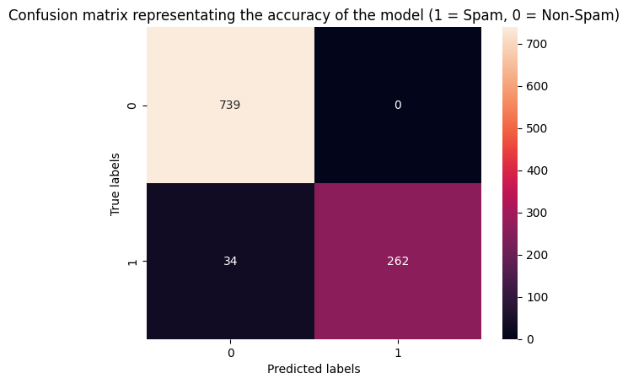
Accuracy of the model

Slide 9
Conclusion
Importance of detecting email spam:
Protects users from scams, phishing attacks, and malware.
Saves time and resources by reducing the number of unwanted emails received.
Future directions for the project:
Improve the performance of the machine learning models by experimenting with different preprocessing steps and feature extraction techniques.
Explore the use of deep learning models for email spam classification.
Extend the project to include real-time classification of incoming email messages.
Overall our model was able to achieve 96.71% accuracy.

Slide 10
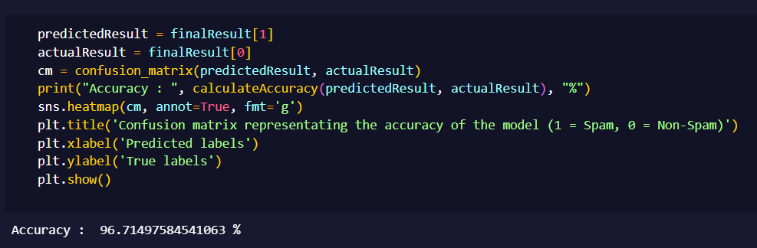

Slide 11
Thank you!

